Slide 1



DMS672
DATA MINING AND KNOWLEDGE DISCOVERY
Course Instructor: Dr. Faiz Hamid
Twitter-Based Sentiment Analysis: Russia–Ukraine Conflict
Durgesh Bhimraoji Dongre(241040020)
Riya Sharma(241080088)
Tandrima Saha (241290618)
Vinay Asish Yedlapalli (241050092)

Slide 2

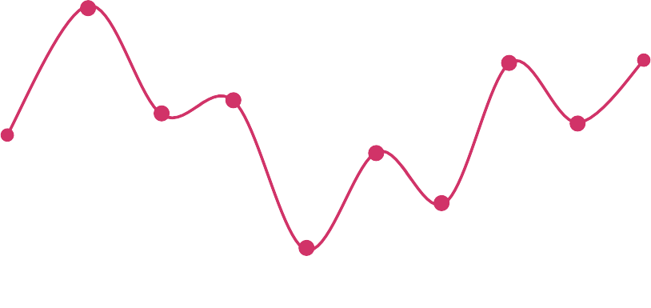
BRIEF OVERVIEW
Topic Overview
Data set overview
Preprocessing and EDA
Sentiment Analysis
Emotion Analysis
Visualizations
Classification
Conclusions

Slide 3

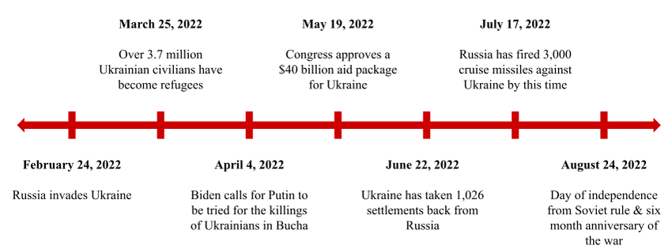
Topic Overview
Analyzed 1.2M tweets on the Russia-Ukraine conflict using NLP ✨
Focused on public sentiment, engagement, and emotions
Combined EDA, sentiment analysis, and ML techniques for insights
Timeline showing key events in the Russo-Ukrainian War
Understanding public opinion and emotional response during the Russia–Ukraine war.
Identifying trends, misinformation, and global support or opposition.
Useful for policymakers, media, and researchers to gauge real-time sentiment shifts.

Slide 4

DATA SETS SUMMARY
📊Rows: 708,764 tweets
🖥️GPU Available: NVIDIA TITAN RTX, Accelerated transformer training
🤖Model : RoBERTa
🧰Libraries: NLTK, tqdm, pandas, HuggingFace Transformers and scikit-learn.
Columns: 28 features
username, acctdesc, location,followers, following, totaltweets, tweetcreatedts, text, hashtags
Engagement: retweetcount, favorite_count
Context: is_retweet, original_tweet_id, is_quote_status
NLP targets: text, language.

Slide 5

Data Preprocessing and Exploratory Analysis

Slide 6
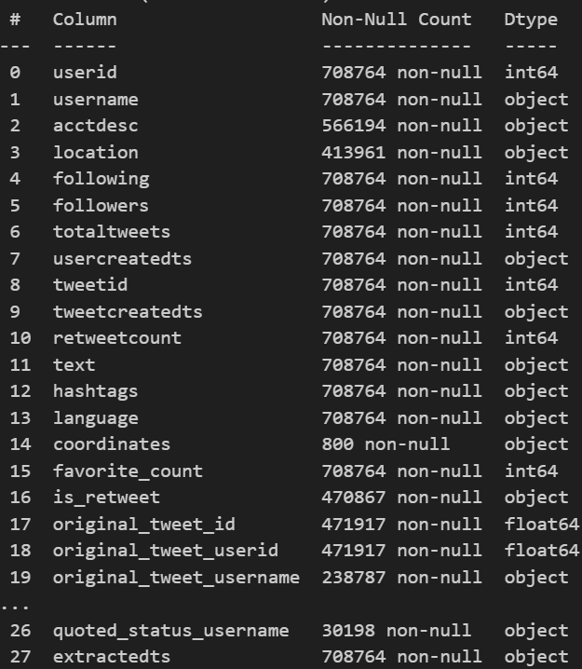
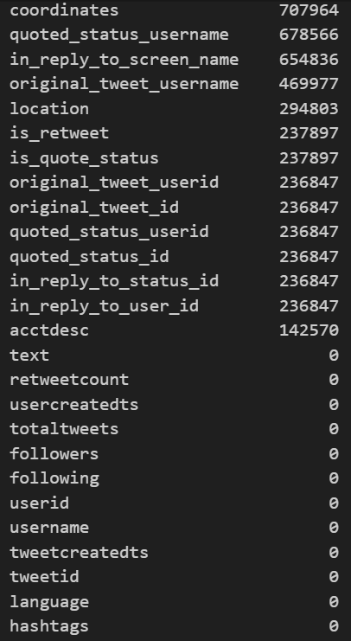
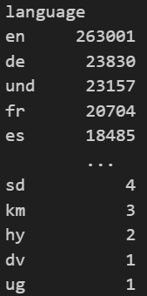
Data Preprocessing
Dataset of 708k tweets with user, tweet, and metadata fields, including text, hashtags, location, and engagement metrics.
Fields like coordinates, quoted_status, and reply info have high missing values while core tweet content and engagement fields are complete
The dataset contains tweets in 64 languages, with English (en) being the most common by far

Slide 7
Visualizations

Slide 8
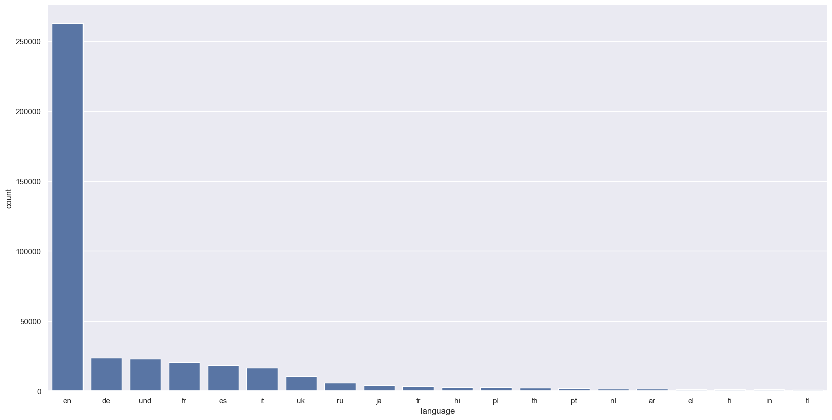
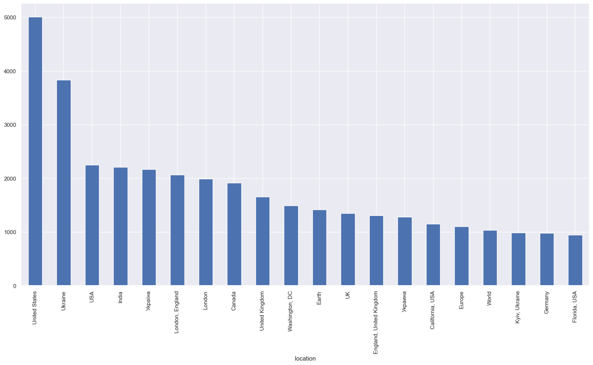
Tweets based on languages
Tweets based on location
English overwhelmingly dominates tweet language, followed by German, French, and Spanish.
Most tweets originate from the United States, Ukraine, and India, with wide global participation.

Slide 9
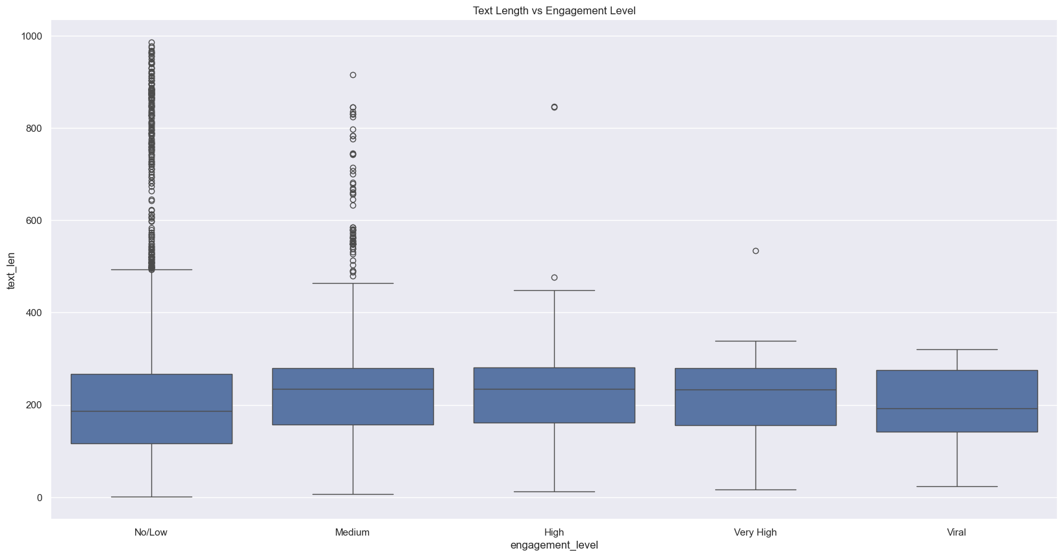
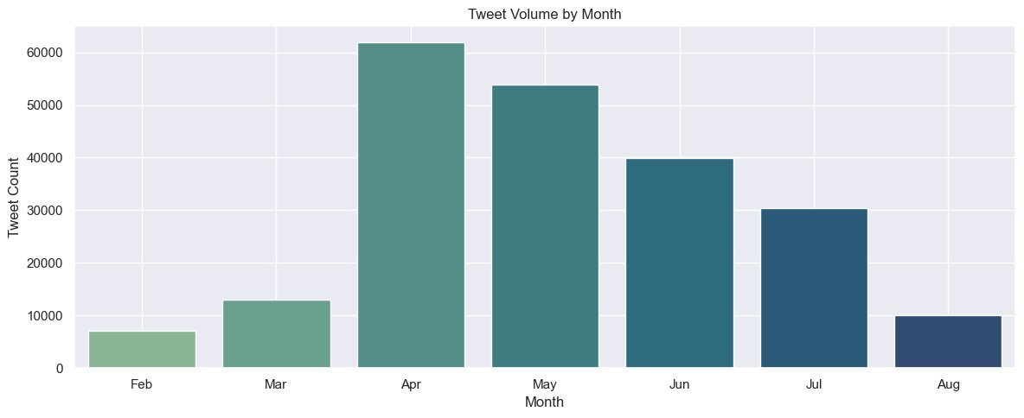
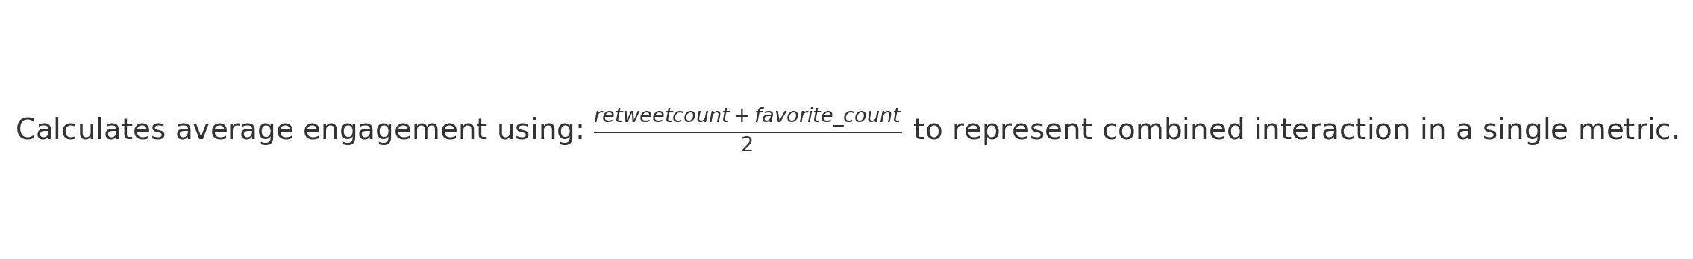
Text Length vs Engagement Level: Higher engagement tweets tend to have slightly longer text lengths with less extreme outliers. No/Low engagement tweets show greater variability and more outliers in text length.
Tweet Volume by Month: Tweet activity peaked in April and May, followed by a consistent decline through August. February and August had the lowest tweet volumes, indicating less user activity.

Slide 10
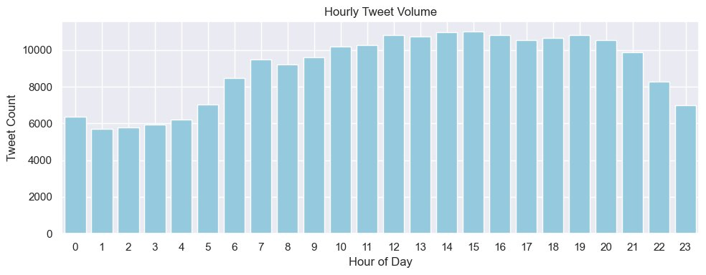
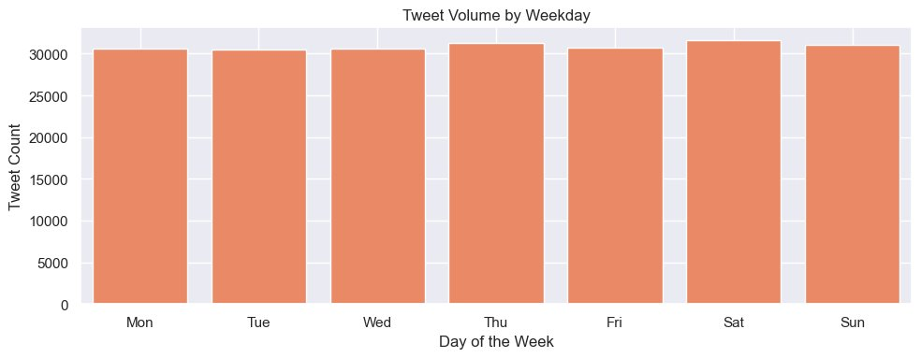
Tweet Volume by Weekday
Tweet volume remains relatively consistent across all days, with a slight peak on Saturday.
No significant weekday stands out, suggesting uniform engagement throughout the week.
Hourly Tweet Volume
Tweet activity steadily increases from early morning and peaks between 14:00 and 16:00 hours.
There is a noticeable dip in tweeting after 21:00, indicating lower user activity late at night.

Slide 11
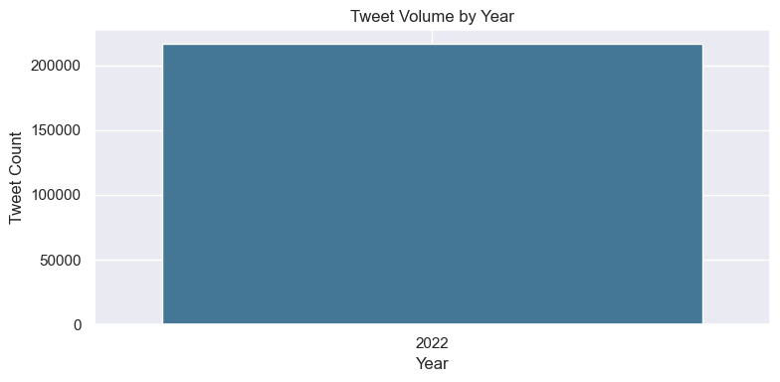
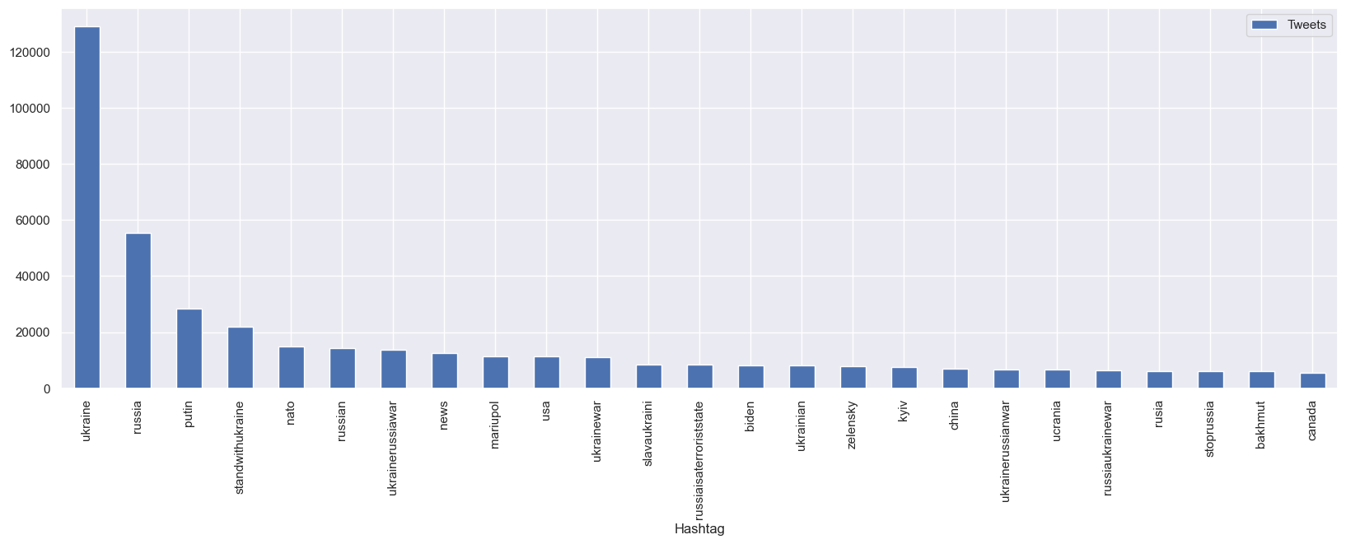
Extracted and normalized hashtags using unidecode, then removed duplicates for each tweet.
#ukraine, #russia, and #putin dominate the most used hashtags during the conflict.

Slide 12

Understanding RoBERTa for Sentiment & Emotion Classification
RoBERTa stands for Robustly Optimized BERT Pretraining Approach
Transformer-based language model introduced by Facebook AI
Designed to improve upon BERT (Bidirectional Encoder Representations from Transformers) by optimizing the training procedure.
Feature | BERT | RoBERTa
Masking Strategy | Static | Dynamic (varies every epoch)
Training Corpus Size | 16GB | 160GB (10x more data)
Next Sentence Prediction | Used | Removed
Batch Size | Small (256) | Larger (up to 8k)
Training Time | Shorter | Longer with more epochs
PROS OF RoBERTa
faster, more robust, and more accurate, especially on downstream tasks like sentiment and emotion classification

Slide 13
How RoBERTa works internally ?
Pretrained on large corpora
Context-aware: Handles sarcasm, negation, and multi-sentence meaning better than traditional models
Multilingual and domain-specific variants available
Easy to integrate via Hugging Face Transformers
Self-Attention Mechanism
RoBERTa
Positional Encoding
Pretraining Tasks

Slide 14
Sentiment Analysis
Technology: RoBERTa, TextBlob

Slide 15
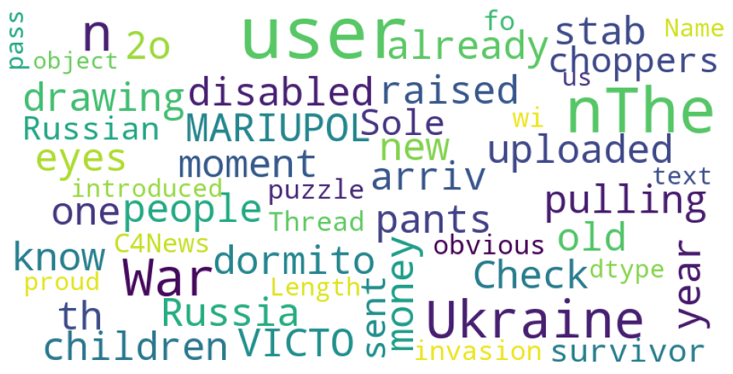
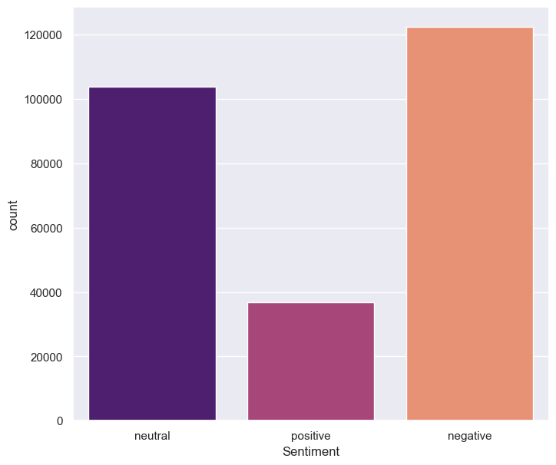
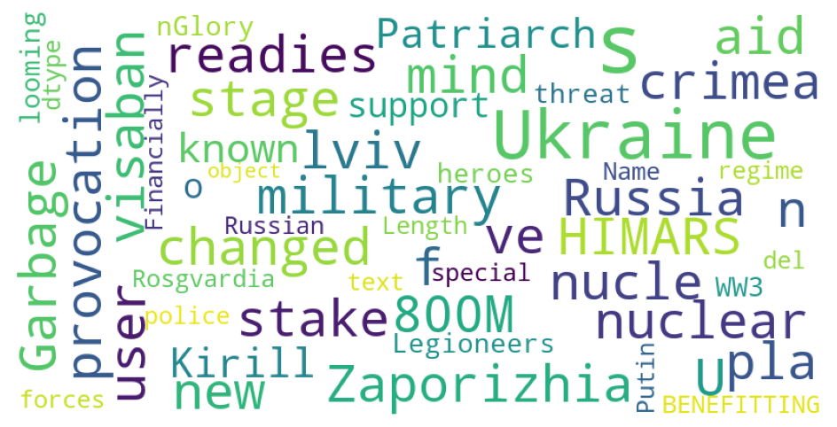
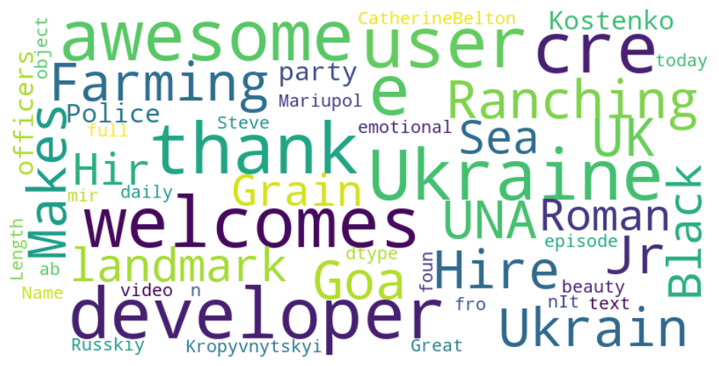
VISUALIZATION OF SENTIMENT ANALYSIS
NEGATIVE
NEUTRAL
POSITIVE
#wordcloud

Slide 16
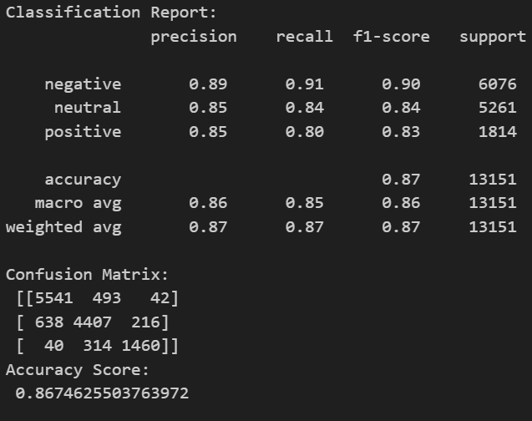
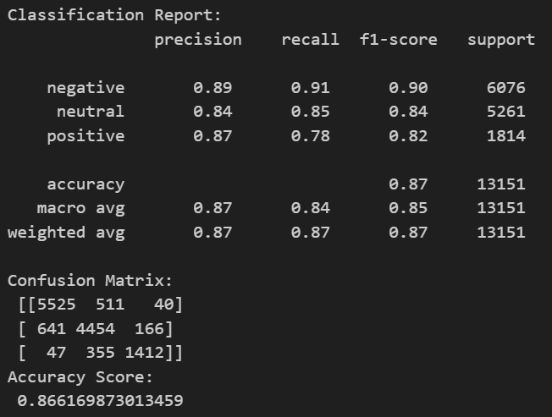
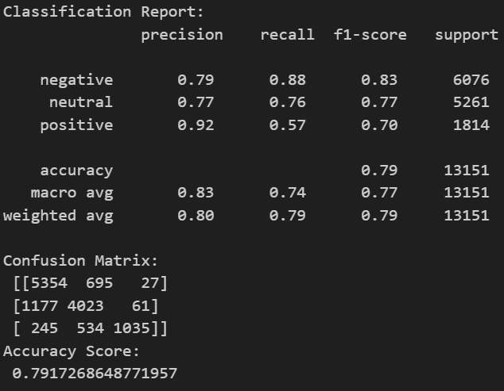
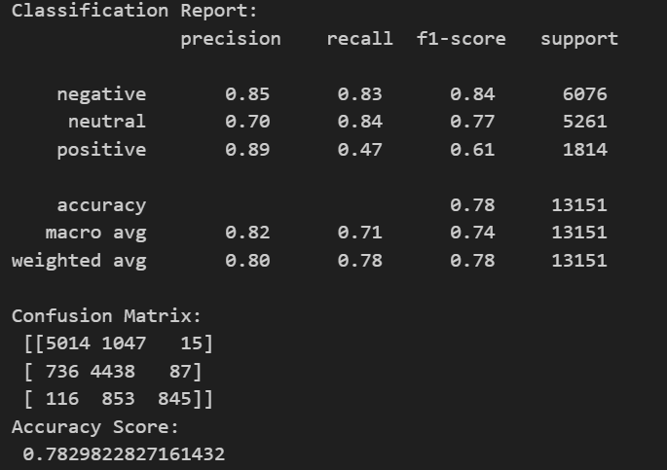
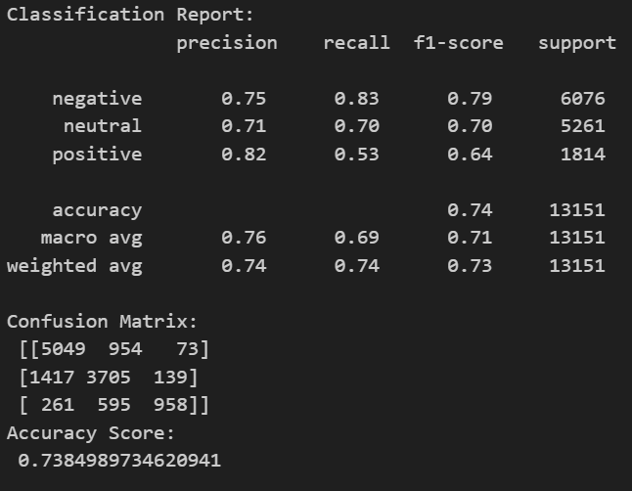
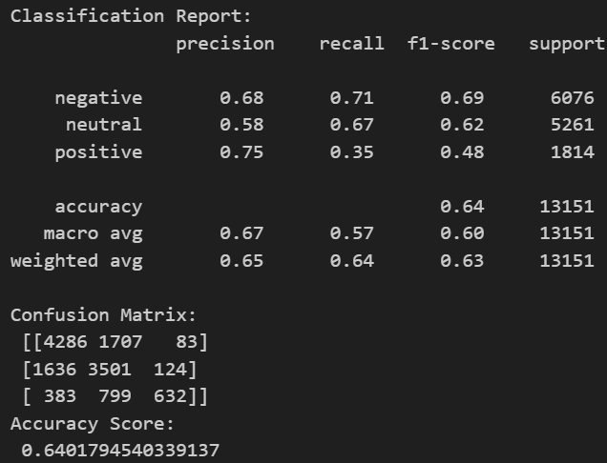
CLASSIFICATION ANALYSIS FOR SENTIMENT
SUPPORT VECTOR CLASSIFICATION
LOGISTIC REGRESSION
RANDOM FOREST CLASSIFIER
BERNOULLI MODEL
K NEAREST NEIGHBOR (K-NN Model)
DECISION TREE CLASSIFIER

Slide 17
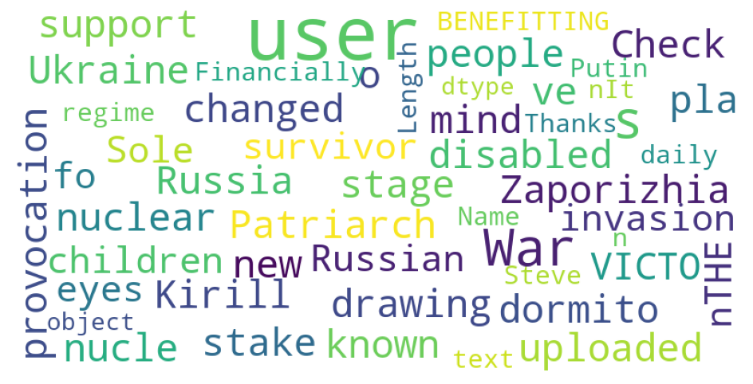
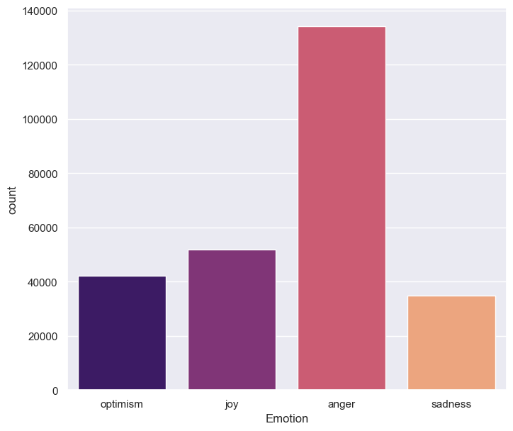
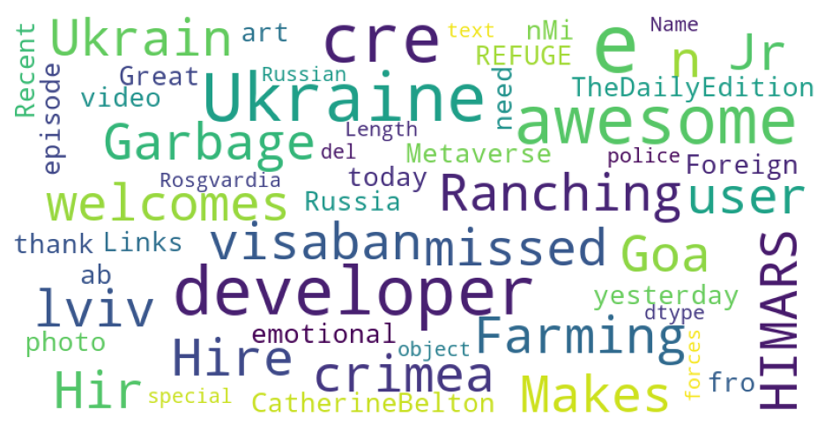
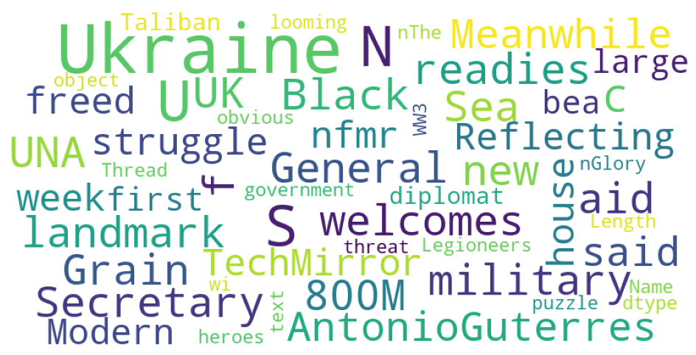
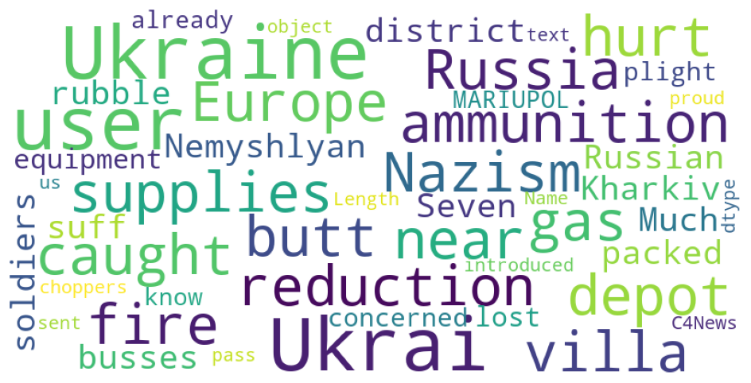
VISUALIZATION OF EMOTION ANALYSIS
ANGER
JOY
OPTIMISM
SADNESS

Slide 18
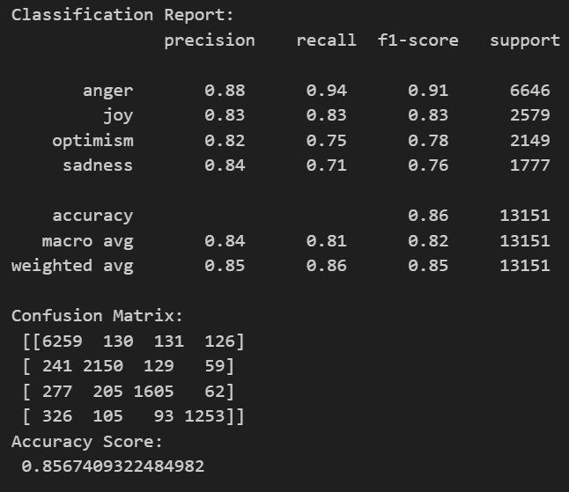
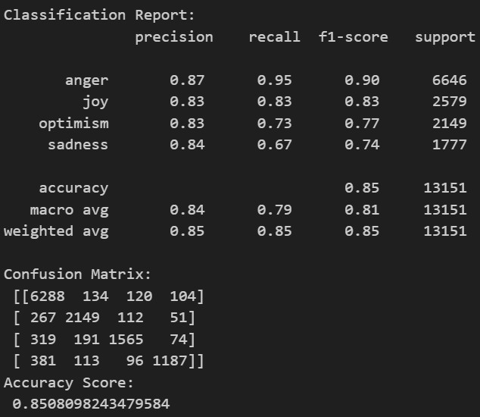
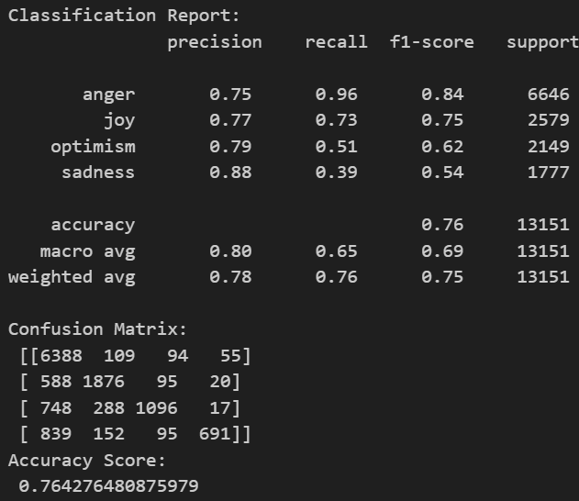
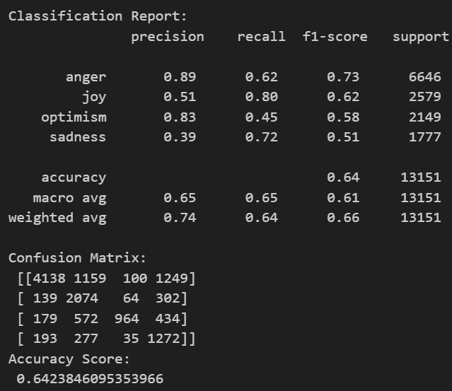
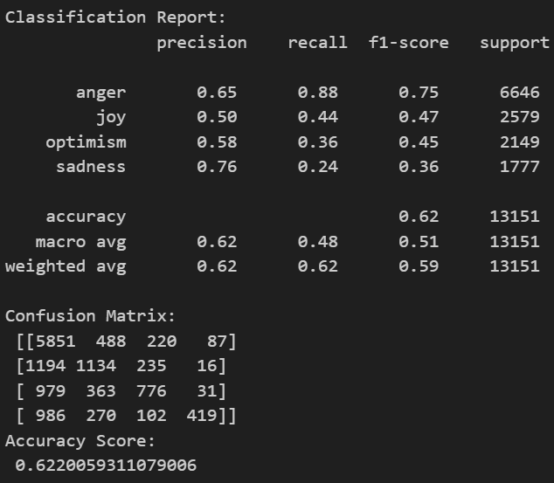
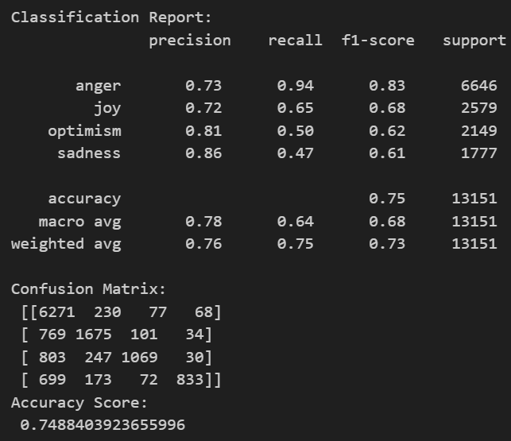
CLASSIFICATION ANALYSIS FOR EMOTION
SUPPORT VECTOR CLASSIFICATION
LOGISTIC REGRESSION
BERNOULLI MODEL
RANDOM FOREST CLASSIFIER
K NEAREST NEIGHBOR (K-NN Model)
DECISION TREE CLASSIFIER

Slide 19
Conclusions

Slide 20
Main takeaways
The sentiment breakdown follows a normal distribution, with a slight skew towards the negative sentiment & anger emotion.
Polarity was not related to the number of refugees ﬂeeing Ukraine, nor was it related to the number of casualties.
Finally, a SVC classiﬁcation algorithm was the best predictor of compound sentiments with a 86.67% accuracy for sentiment & 86.74% accuracy for emotion .

Slide 21
THANK YOU

